Slide 1
Common Grid Service Terms Motivation for NAESB Standards Request R22001 NAESB RMQ-BPS Meeting Presentation 11 April 2023
Reliable
Resilient
Secure
DOE Grid Modernization Laboratory Consortium (GMLC)
Grid Modern-
ization
Rich Brown, Principal Investigator
Lawrence Berkeley National Laboratory
Steve Widergren, co-PI
Pacific Northwest National Laboratory
Sustain-
able
Affordable
Flexible

Slide 2
Topics
Level setting
DOE and National Lab interest in grid services
Standards request R22001 – objectives
Service/performance-oriented principles
State of transmission grid services
Outcome of the WEQ-BPS R22001 work
Service descriptions
Examples mapping existing industry services to common services
State of retail market grid services
Desired outcome of effort

Slide 3
DOE & National Lab Grid Service Interest
Trends: operating the electric grid is growing in complexity
Variable renewable resource growth challenges the traditional operating paradigm
Electrification of more end-use applications increasing demand
Affordable communications and intelligence appearing at distribution level (infrastructure and customers)
Greater opportunities for flexible grid-edge resources to coordinate their operation with the system
Flexible grid-edge resources: responsive generation, storage, and demand
Challenge: integration and interoperation of vast numbers of devices, systems, and participants
Significant equipment purchased, operated, and maintained by non-grid entities
Technology is changing and mixture is constantly evolving
Many technology suppliers with various novel solutions
Many jurisdictions with different rules, regulations, and business processes
National labs (GMLC) working on standard Energy Services Interface (ESI) to improve interoperability of grid-edge resources
Builds on a foundation of common grid service definitions

Slide 4
Standards Request R22001
Objective:
Classify common grid services that accommodate the diverse grid needs in different regions
Define common grid service types for wholesale power system interactions
Derive commonalities and important variations found in existing grid services
Meet near to mid-future needs gathered from major US ISO/RTOs and utilities
Accommodate specialization: performance characteristics and expectations
Qualification, performance expectations, monitoring, reconciliation, and settlement vary by operational policy of each region
But defining common policy was beyond the scope of the effort
Benefit:
Provides consistent service-type names, definitions, and performance characteristics
Encourages adoption of consistent terminology in wholesale markets
Provides starting place for retail-level grid service interactions with flexible, grid-edge resources

Slide 5
Service-Oriented Principles
Important to distinguish grid Operational Objectives from Services
Operational objectives describe why a service is used
Use cases help describe the desired performance characteristics from a service
Examples: schedule energy to meet peak load forecast, or reserve energy for outage contingency
Services define what is to be performed – not how
Example: generation needs to be at nominal power level 100 MW in 10 minutes and maintained for 1 hour
Any equipment type that meets the performance requirement can provide the service
Service provider understands what to do, where, and when – not why
Boundaries of responsibility are clearly understood between service requester and provider
The service requestor’s reasons for invoking the service (the operational objectives) are hidden
Example: a gas-turbine generator does not need to know it is scheduled for peak-load coverage
Benefits
Decouples areas of concern – makes integration simpler, cleaner, modular
Same service can be used to address multiple objectives
Accommodates service provider technology decisions within performance requirements

Slide 6
State of Grid Services – GMLC Review
Literature review
Summary of transmission grid service categorization models
Denholm, Cappers, FERC, NERC, PNNL’s grid services report, etc.
Performance expectations v. operational objectives
Review and correlation of transmission grid service terms and definitions
FERC, NERC, CAISO, PJM, SPP, Hawaiian Electric
State of Common Grid Services Definitions, GMLC report:
https://escholarship.org/uc/item/75d2n2dw

Slide 7
Outcome of WEQ R22001 Effort
Classification of a (small) set of grid services
Common names for these grid-service types
Clear definitions of the service types
Parameterized performance expectations (i.e., electrical attributes, timing attributes)
Accommodate necessary specialization
Effort did NOT,
Propose a uniform market policy on services
Prescribe a solution for DER integration into wholesale electric markets
Specify DER management technology or platforms

Slide 8
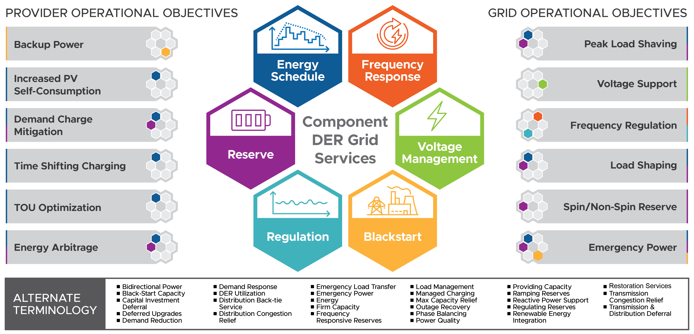
Summary of Common Grid Services

Slide 9
Format of Work Product
Grid service name: short title of the service
Description: short (1- or 2-sentence) definition of the service
Performance expectation: parameters that describe the expected performance delivered
Electrical attributes:
Electricity-related quantities or qualities (e.g., power, energy, voltage level) over the performance period.
Electrical location: the physical location where the service is delivered in the electric system.
Timing attributes:
Delivery schedule: period over which the grid service is expected to take place.
Delivery schedule notification: timing associated with notification that the delivery schedule for a service is established.
Response time: Response time is the allowed elapsed time between the moment when the grid service is to start and the moment when the desired behavior meets the defined threshold for a given grid service.
Performance determination: typical ways the service is measured for verification
Additional information missing from standard
Example service requestor operational objectives: applications for calling the service
Origin of service definition: context or background on why the service exists

Slide 10
Grid Services – WEQ-000 definitions
Energy Grid Service: A type of service in which a resource provides a quantity of energy over a scheduled period of operation.
Reserve Grid Service: A type of service in which a resource provides energy when called upon by the system operator over a commitment period.
Regulation Grid Service: A type of service in which a resource continuously increases and decreases energy in response to real-time signals from the system operator over a commitment period.
Frequency Response Grid Service: A type of service in which a resource reacts or responds to a change in system frequency by altering its power levels
Voltage Management Grid Service: A type of service in which a resource provides voltage support within a specified upper and lower voltage range over a commitment period.
Blackstart Grid Service: A type of service in which a resource can energize or remain energized without an outside electrical supply.

Slide 11
Attribute Summary
Grid Service | Energy | Reserve | Regulation | Frequency Response | Voltage Mgmt | Blackstart
Electrical Attributes | energy (quantity) | energy (quantity) | power (level) | percent droop | target voltage or range | power (level)
 | power (level) | power (level) | power regulation range | deadband | electrical location | power regulation range
 | electrical location | electrical location | power mileage | electrical location |  | electrical location
 |  |  | electrical location
Timing Attributes | delivery schedule | delivery schedule | delivery schedule | delivery schedule | delivery schedule | delivery schedule
 | del sched notification | del sched notification | del sched notification | del sched notification | del sched notification | del sched notification
 |  | speed of response | speed of response |  | signal periodicity | speed of response
 |  |  | signal periodicity
Performance Determinations | agreements specify: a) measurement equipment and location, b) measurement units and frequency, and c) calculations of estimating methods. Examples: revenue grade energy interval meters or periodic power measurements to estimate energy. | agreements specify how performance is quantified such as energy interval meters and time-stamped power measurements. | agreements specify how real power increase or decrease is measured. A performance score or index mechanism may be applied. | agreements specify how performance is quantified with frequency response measurements. | agreements specify how performance is quantified. | agreements specify how performance is quantified.

Slide 12
Industry Energy Grid Service Examples
 |  | CAISO - DA & Hourly | SPP - DA & RT Balancing | PJM - DA & RT
Grid Service | Energy | Energy Services | Energy Service | Energy Market
Electrical Attributes | energy (quantity) | MWh | MWh | MWh
 | power (level) | MW, $/MW curve | MW, $/MW curve | MW, $/MW curve
 | electrical location | producing & delivery nodes | ENodes linked to PNodes | pnode tied to physical connect
Timing Attributes | delivery schedule | DA 24 hrs, Hour: 1 hr prior in 5-min increments | DA 24 hrs, RTBM: 30 min prior in 5-min increments | DA 24 hrs, RT: 65 min prior in 5-min increments
 | del sched notification | DA 1pm day prior, Hour: 45-min prior | DA 1pm day prior, RTBM: not published prior | DA 1:30pm w/ rebidding 2:15pm day prior, RT: not published prior
Performance Determinations | agreements specify: a) measurement equipment and location, b) measurement units and frequency, and c) calculations of estimating methods. Examples: revenue grade energy interval meters or periodic power measurements to estimate energy. | revenue quality energy interval meter certified by CAISO reading at point of interconnection. 5- or 15-minute intervals. Estimation procedure used if there is a measurement failure. | revenue quality energy meters at the Pnodes at least hourly or every 5 minutes synchronized to delivery intervals. Real-time power used as backup | “For each hour of the Operating Day, PJM calculates an hourly-integrated telemetry MWh value using the time-weighted telemetry MW values for each of the five-minute intervals in the hour”

Slide 13
Industry Reserve Grid Service Examples
 |  | CAISO - DA & Hourly |  | SPP - DA & RT
Grid Service | Reserve | Spinning | Non-spinning | Spinning | Supplemental
Electrical Attributes | energy (quantity) |  |  | MWh | MWh
 | power (level) | MW, $/MW curve | MW, $/MW curve | MW, $/MW curve | MW, $/MW curve
 | electrical location | ancillary service region | ancillary service region | reserve zone | reserve zone
Timing Attributes | delivery schedule | DA 24 hrs, Hour: 1 hr prior | DA 24 hrs, Hour: 1 hr prior | DA 24hrs, RT 30-min prior | DA 24hrs, RT 30-min prior
 | del sched notification | DA 1pm day prior, Hour: 45-min prior | DA 1pm day prior, Hour: 45-min prior | DA 6am day prior, Hour: not published prior | DA 1pm day prior, Hour: not published prior
 | speed of response | 1 min | 10 min | 10 min from online | 10 min from offline
Performance Determinations | agreements specify how performance is quantified such as energy interval metersand time-stamped power measurements. | Selected equipment is to be on-line | settlement quality energy meter in 5-min intervals | equipment capable to respond within 10 min of notice | revenue quality energy meter in 5 min intervals. Where unavailable telemetered power scanned every 10 sec.

Slide 14
State of Retail grid-DER Services
Drivers for coordinating DER flexible operation has largely been wholesale market driven
Retail engagement terms have been program-oriented, not service-oriented
Demand response
Demand-side management
Demand caps
Congestion management
Emergency load reduction
Time-variable pricing programs
Time-of-use
Dynamic time-of-use
Peak pricing
Critical peak pricing
Real-time pricing
Day-ahead pricing
Observations
Programs named and designed around operational objectives rather than the service to be provided.
The services seem to fall into a couple categories:
A. energy grid-DER service
B. reserve grid-DER service
Other wholesale grid services not yet practical

Slide 15
Desired Outcome of Effort
Classification of a (small) set of grid services for retail markets
Consistent with R22001 if possible
Common names for these grid-service types
Clear definitions of the service types
Parameterized performance expectations (i.e., electrical attributes, timing attributes)
Accommodate necessary specialization
Examples of how existing retail grid-DER programs map into common services
As much commonality as possible between wholesale and retail grid services
Effort does NOT,
Propose a uniform market policy on retail services
Prescribe a single solution for DER integration into wholesale or retail electric markets
Specify DER management technology or platforms

