Slide 1
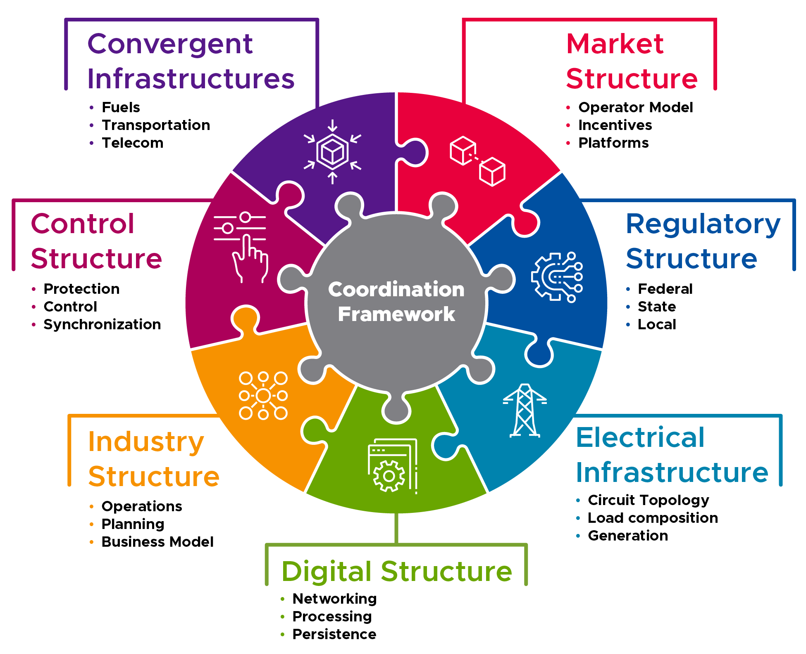

Reference Coordination Architecture Document
For access to draft document, contact us at: jaime.kolln@pnnl.gov
christopher.klasen@pnnl.gov
by scanning the QR code below.
DRAFT

Slide 2
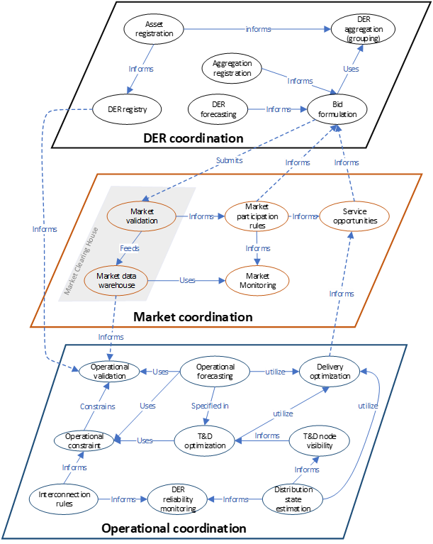

Slide 3
A Method to Develop an Energy Services Interface
Reliable
Resilient
Secure
DOE Grid Modernization Laboratory Consortium (GMLC)
Grid Modern-
ization
Sustain-
able
Affordable
Jaime T Kolln, PNNL November 2024
Under GMLC 2.5.2 - PNNL, LBNL, NREL, ORNL and ANL
Flexible
PNNL-SA-180629

Slide 4
Grid Services/ESI Project Problem Statement
Distributed energy resources (DERs) must be orchestrated at scale of millions of units
Utilities and third-party service providers do not have a single, universal method to implement plug and play coordination with diverse, distributed energy resources within retail customer sites
Today: requires custom engineering and proprietary solutions to integrate DER with utility grids
Non-standard business processes cause administrative burden (soft costs)
Proliferation of standards hinders interoperability, creates “silos” by technology and region
DER coordination mostly done today through direct control (with exceptions of time-varying pricing)
Potential for mismatch between grid & customer operational objectives
Not adaptable to changes in technology or needs of grid and customers
Requires greater data exchange about DER characteristics and state
Impacts customer privacy
Notes:
Problem Statement
Focus is on DERs and trying to get the scale of DERs to impact the bulk power system. Currently, it sits as a relatively diffuse, uncoordinated, untapped resource. An ESI is an enabling technology to enable scale aggregation of DERs.
To do this cost-effectively, this needs to be “Plug and Play” when it comes to grid services.
Having these standards allows all these stakeholders to match DERs with Grid Services, and more importantly, OEM’s need to know how design for these grid services.

Slide 5
Vision: A Common Grid-DER Service Interface
Current Challenge: Myriad device classes & grid services makes understanding potential & integrating solutions a scalability nightmare
Solution: The Energy Services Interface (ESI) as a an interoperability standard for grid-DER coordination
Device Classes
Water Heaters
PV/Inverters
Battery/Inverters
Electric Vehicles
Fuel Cells
Electrolyzers
Air Conditioners
Commercial Refrigeration
Device Class N+1
Grid Services
Service 1 (e.g., Peak Load Management)
Service 2
Service 3
Service 4
Service 5
Service 6
Service 7
Service 8
Service N+1
Grid Services
Service 1 (e.g., Peak Load Management)
Service 2
Service 3
Service 4
Service 5
Service 6
Service 7
Service 8
Service N+1
Device Classes
Water Heaters
PV/Inverters
Battery/Inverters
Electric Vehicles
Fuel Cells
Electrolyzers
Air Conditioners
Commercial Refrigeration
Device Class N+1
ESI

Slide 6
GMLC Project Objectives
To scale DERs cost-effectively need simplified, unified interoperability
“Plug and play” configuration
Self-identification of DER capabilities
Auto-discovery
Service-oriented coordination architecture
Project Objectives
Define common terms and framework to represent grid services
Types of operational arrangements for interactions between facilities and the grid
Applicable to any grid entity and device type that meets performance qualifications
Accommodate diverse grid and customer needs, tailored for different regional jurisdictions
Develop universal Energy Services Interface (ESI) specification to simplify DER integration & support DER business models
Facilitate development of communication interface standards independent of device and grid
Accelerate industry agreement on ESI standardization approaches to improve grid-edge interoperability
Notes:
We’re starting from several GMLC projects with strong integrated teams and foundational research

Slide 7
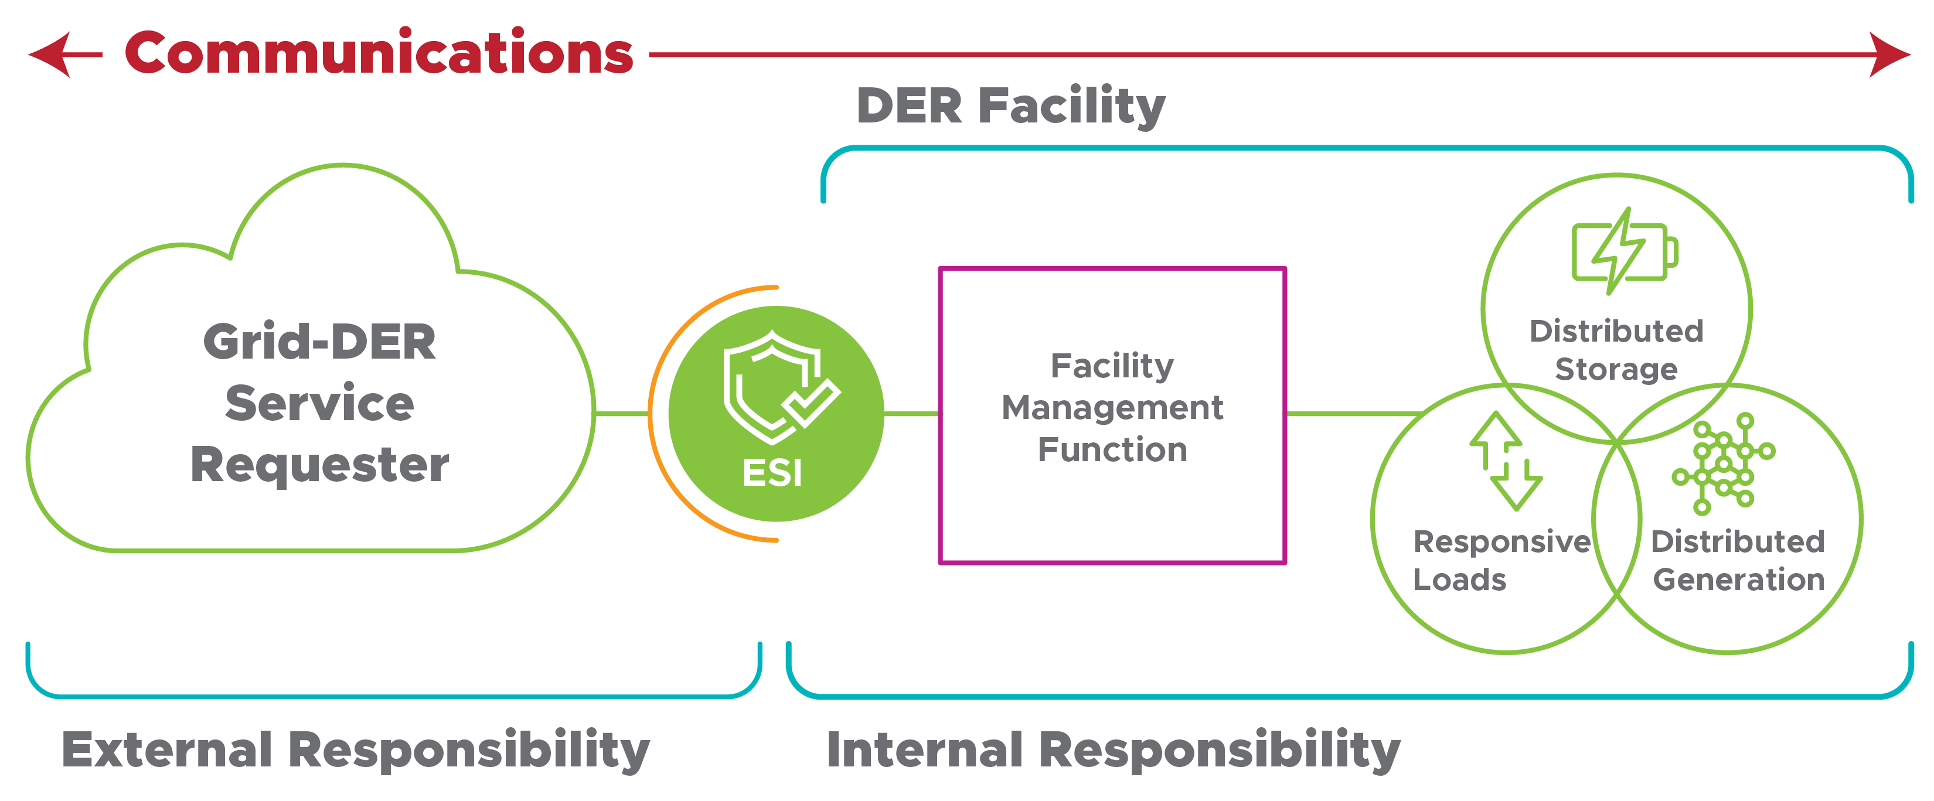
Energy Services Interface (ESI):
A Vision for DER Integration
Develop universal method to simplify orchestration of DERs at the scale of millions of units
Service-oriented coordination architecture – what is provided, not how
“Plug-and-play” configuration - Auto-discovery, Self-identification of DER capabilities
"An ESI is a bi-directional, service-oriented, logical interface that supports the secure communication of information between entities inside & entities outside of a customer boundary to facilitate various energy interactions between electrical loads, storage, & generation within customer facilities & external entities.“ (Hardin et al.: https://gmlc.doe.gov/sites/default/files/resources/InteropRoadmapMethodologyV1-1.pdf)
Notes:
The key is the grid communicates the service it needs, not how to deliver the service. That function remains on the facility side so that the customer can choose how to respond in the most effective and least disruptive way.
Through previous GMLC 1.0 projects, we confirmed the fundamental need for an ESI.
Our DER integration vision includes working with industry to develop a common understanding of the functional specifications for an ESI to address the grid services framework.
Grid service is about what’s communicated between the grid and DER, and the ESI is about how it’s communicated across different grid architectures and business models.

Slide 8
Fundamental ESI Principles
The ESI is service-oriented: The interface is used to communicate what is needed, not how to deliver it.
Grid-DER services are described in terms of performance requirements, not device specific functionalities.
This approach embraces a distributed, decision-making scalable coordination framework that emphasizes modularity and loose coupling of the interacting system components.
This architecture facilitates automated (machine-to-machine) communications to support business practices (to provide Grid-DER Services).
The ESI maintains privacy: This core principle is intended to satisfy information privacy concerns.
The facility management function does not expose the identity or other details of individual DER, but rather only the collective capability of all DER in the DER Facility for a particular Grid-DER service.
Boundaries of responsibility on either side of the ESI, are clear and protected by the style of the interface.
The ESI is device agnostic: The ESI is universally applicable to all types of DER if they qualify to address the agreed upon grid-DER service.
This avoids specialized interfaces based on DER technology type and streamlines adaptation to new DER technology or advances in existing technology.

Slide 9
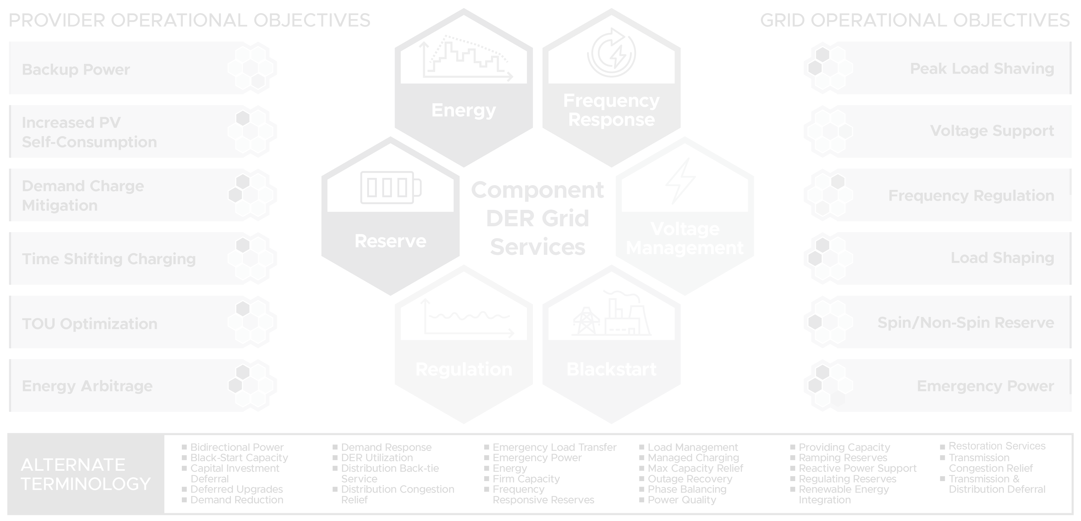
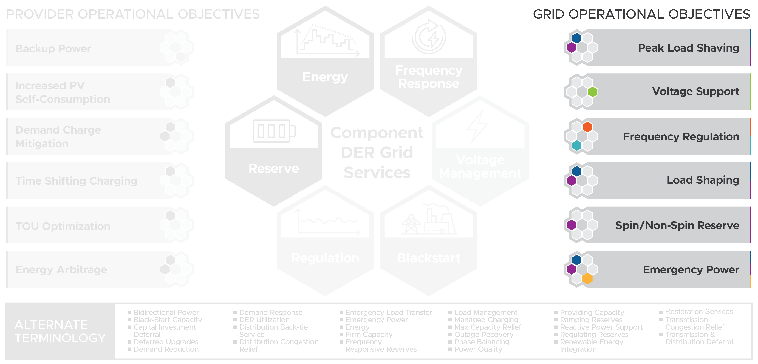
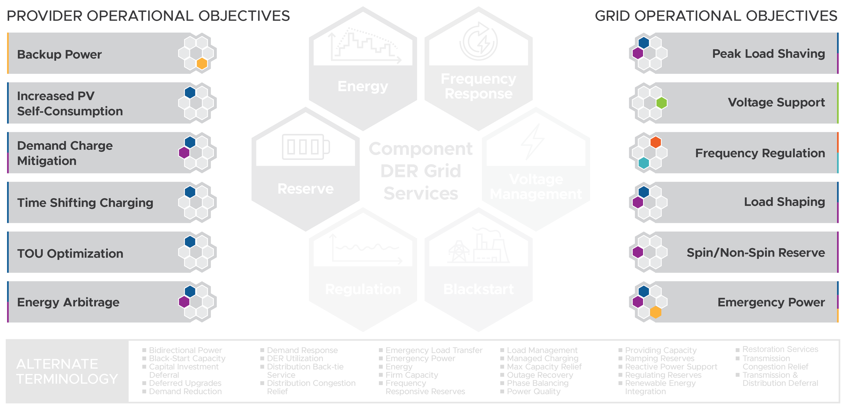
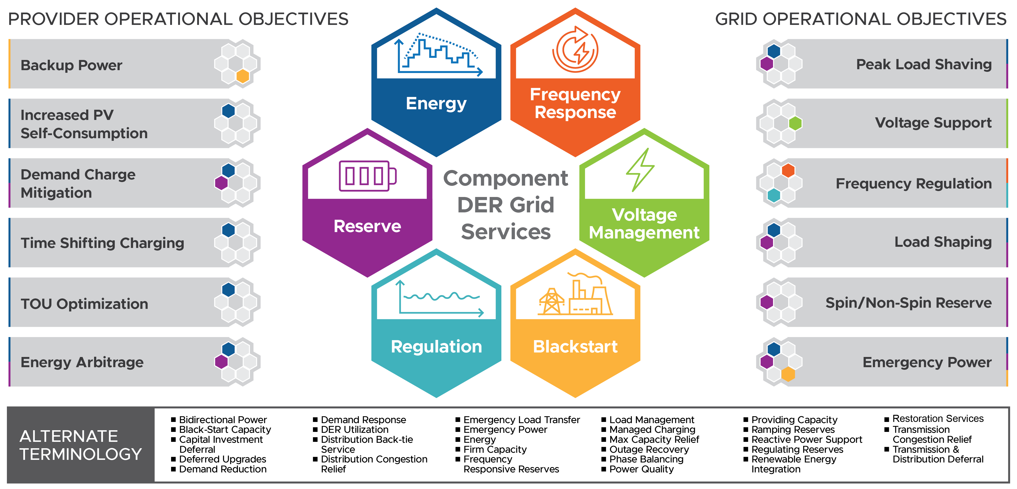
Common Grid Service Definitions

Slide 10
Format of NAESB Work Product
Grid service name: 1- or 2-word title of the service
Description: short (1- or 2-sentence) definition of the service
Performance expectation: parameters that describe the expected performance delivered
Electrical attributes:
Electricity-related quantities or qualities (e.g., power, energy, voltage level) over the performance period.
Electrical location: the physical location property where the service is delivered in the electric system.
Timing attributes:
Delivery schedule: period over which the grid service is expected to take place.
Delivery schedule notification: timing associated with notification that the delivery schedule for a service is established.
Response time: Response time is the allowed elapsed time between the moment when the grid service is to start and the moment when the desired behavior meets the defined threshold for a given grid service.
Additional information
Performance measurement examples: typical ways the service is measured for verification
Example service requestor operational objectives: applications for calling the service
Origin of service definition: context or background on why the service exists
Notes:
WEQ-025: NAESB glossary

Slide 11
Grid Services – WEQ-025 definitions
Energy Grid Service: A type of service in which a resource provides a quantity of energy over a scheduled period of operation.
Reserve Grid Service: A type of service in which a resource provides energy when called upon by the system operator over a commitment period.
Regulation Grid Service: A type of service in which a resource continuously increases and decreases energy in response to real-time signals from the system operator over a commitment period.
Frequency Response Grid Service: A type of service in which a resource reacts or responds to a change in system frequency by altering its power levels
Voltage Management Grid Service: A type of service in which a resource provides voltage support within a specified upper and lower voltage range over a commitment period.
Blackstart Grid Service: A type of service in which a resource can energize or remain energized without an outside electrical supply.

Slide 12
Attribute Summary
Grid Service | Energy | Reserve | Regulation | Frequency Response | Voltage Mgmt | Blackstart
Electrical Attributes | energy (quantity) | energy (quantity) | power (level) | percent droop | target voltage or range | power (level)
 | power (level) | power (level) | power regulation range | deadband | electrical location | power regulation range
 | electrical location | electrical location | power mileage | electrical location |  | electrical location
 |  |  | electrical location
Timing Attributes | delivery schedule | delivery schedule | delivery schedule | delivery schedule | delivery schedule | delivery schedule
 | del sched notification | del sched notification | del sched notification | del sched notification | del sched notification | del sched notification
 |  | speed of response | speed of response |  | signal periodicity | speed of response
 |  |  | signal periodicity
Performance Determinations | agreements specify: a) measurement equipment and location, b) measurement units and frequency, and c) calculations of estimating methods. Examples: revenue grade energy interval meters or periodic power measurements to estimate energy. | agreements specify how performance is quantified such as energy interval meters and time-stamped power measurements. | agreements specify how real power increase or decrease is measured. A performance score or index mechanism may be applied. | agreements specify how performance is quantified with frequency response measurements. | agreements specify how performance is quantified. | agreements specify how performance is quantified.

Slide 13
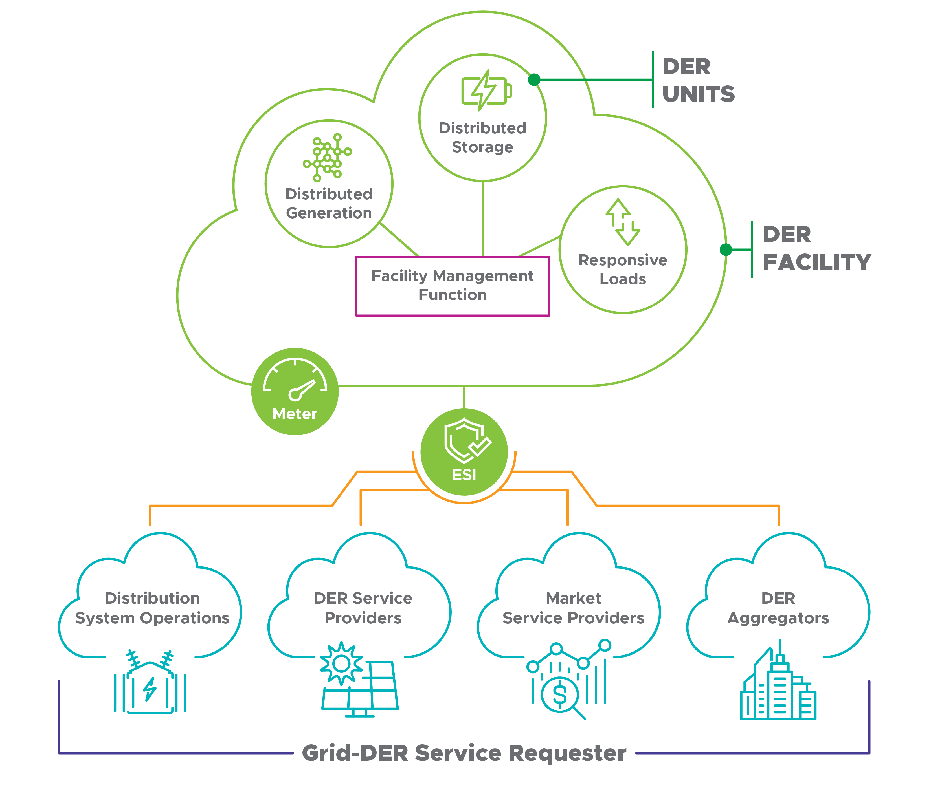
About the DER Facility
The “DER facility” hosts one or many DERs and the associated facility management function.
Abstracts the DER communication away from direct control mechanisms of specific devices
Consider: The ESI is essentially a set of requirements for communication in and out of the DER facility platform

Slide 14
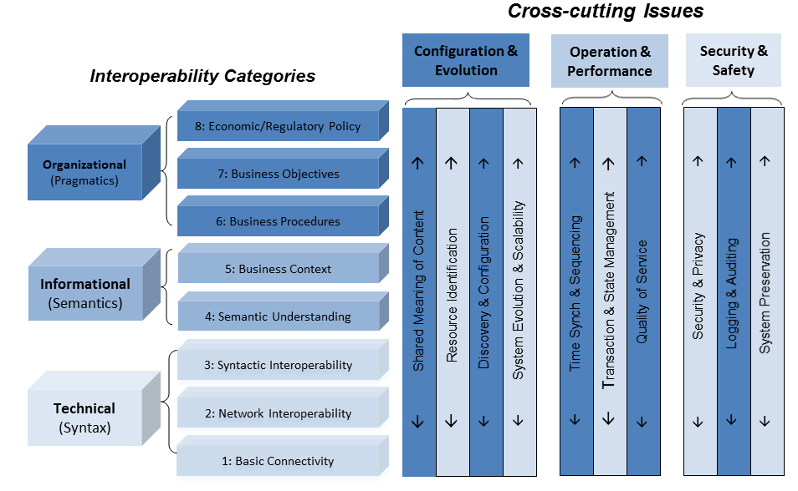
Background: Interoperability Context-Setting Framework
Source: GridWise Architecture Council’s Interoperability Context-Setting Framework
Notes:
Interoperability is “The ability of two or more systems or components to exchange information and to use the information that has been exchanged¹
The Interop Context-Setting Framework diagram, which is used to organize the dimensions of interop in the IMMThe organizational categories emphasize the pragmatic aspects of interoperation. They represent the policy and business drivers for interactions. The informational categories emphasize the semantic aspects of interoperation. They focus on what information is being exchanged and its meaning. The technical categories emphasize the syntax or format of the information. They focus on how information is represented within a message exchange and on the communications medium.

Slide 15
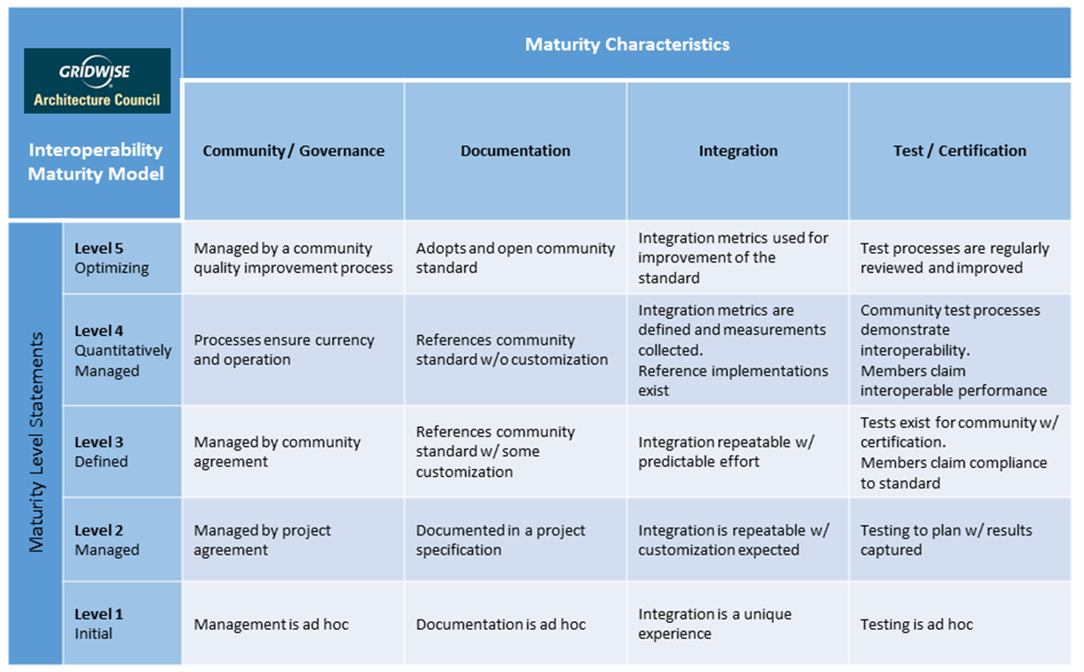
Categories of interoperability (IMM)
Configuration & Evolution
Security and Safety
Operation and Performance
Organizational
Informational
Technical

Slide 16


Example Lifecycle Interactions
Service Provider
Qualify and
Subscribe
Schedule
Resource
Operate
Resource
Measure and Verify
Performance
Get Paid
For Service
Register and Qualify
Schedule
Operate
Measure and Verify
Settle
Contract
Service
Schedule
Service
Engage
Service
Measure and Verify
Performance
Pay for
Service
Service Requester

Slide 17


Example ESI Interactions Energy Service
The Grid-DER Service Agreement defines business and interoperability requirements as well as the responsibilities of both participants across all ESI lifecycle phases: e.g., Registration & Qualification - What are the performance requirements for the service program(s) DER can participate in?
Out of Scope: DER Interconnection Agreement defines codified DER behavior.
Service posted/request made: Need 10MW from 5PM to 7PM
Msg received, internal decisions
Msg received, internal decisions
Service offered: Can provide 1 MWh from 5PM to 7PM for $134
Schedule
Service offer accepted/scheduled/dispatched
Msg received, internal decisions
Performance measured & verified
Operate
Measure & Verify
DER Facility operates.
Performance is measured and verified
Service Settlement
Settle
Service Settlement
ESI Rules In Place
Grid Service
Requestor
Grid Service Provider

Slide 18
Example ESI Interactions Reserve Service
The Grid-DER Service Agreement defines business and interoperability requirements as well as the responsibilities of both participants across all ESI lifecycle phases: e.g., Registration & Qualification - What are the performance requirements for the service program(s) DER can participate in?
Out of Scope: DER Interconnection Agreement defines codified DER behavior.
Service posted/request made: Reserve 10MW from 5PM to 7PM as called upon
Msg received, internal decisions
Msg received, internal decisions
Service offered: Can provide 1 MWh reservation from 5PM to 7PM for $134 if called upon
Schedule
Service offer accepted/scheduled
Msg received, internal decisions
Dispatch signal sent as required. Performance measured & verified
Operate
Measure & Verify
DER Facility operates as signaled
Performance is measured and verified
Service Settlement
Settle
Service Settlement
ESI Rules In Place
Grid Service
Requestor
Grid Service Provider

Slide 19
Ongoing and Future ESI and Grid Service Needs
Standardization and adoption need:
Develop parameterized and automated contracting process – PNNL developing WS-Agreement Framework for Grid Services
Quantify the capability of DER and grid-edge assets to provide the various Grid Services – PNNL applying data set analysis to estimate current availability of physical and digital capability
Eventually will use a variety of scenarios to value such services. Similar to DSO+T – low, medium, high adoption.
Develop profiles that help users more easily implement standards to support Grid Service interactions
Develop Test procedures to score the ability of DER and DER Facility to provide services and which - multi-lab proposal under review
Modeling of system including the electrical and digital network requirements and constraints
Large scale demonstration including but also beyond Energy and Reserve Services

Slide 20
